Slide 1

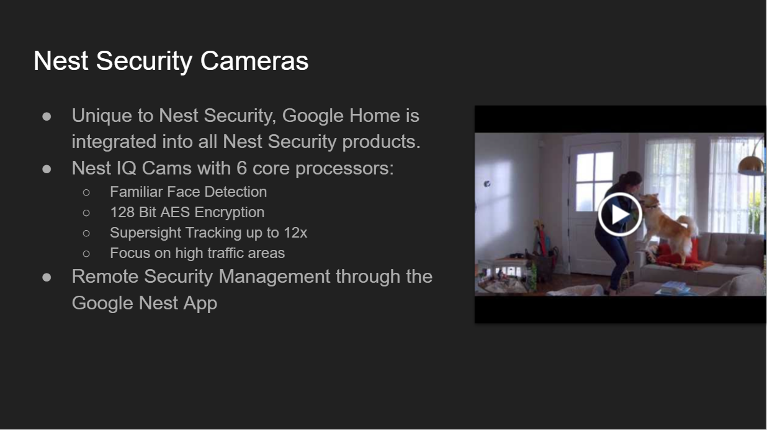
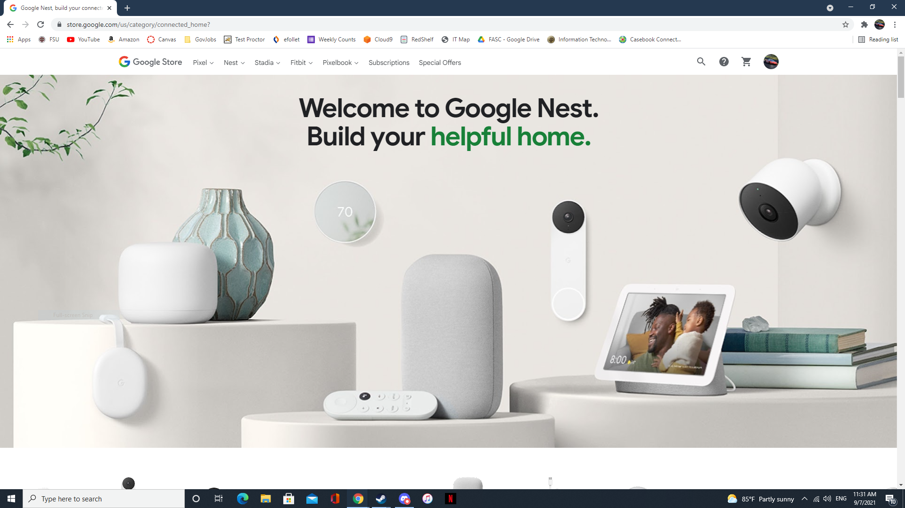




Display 1
Display 2
09/07 8:30 AM
Video 1
No Video
Video 2
Disabled
Preview
Video
Video 1
Video 2
Video 3
Video 4
Video 1 Preview
Video 2 Preview
Audio
Mic 1
Mic 2
Mic 3
Mic 4
Go Live
Go Live
Miscellaneous
Lights
Projectors
Video 1 Duplicate
Settings
Enter Fullscreen

Slide 2
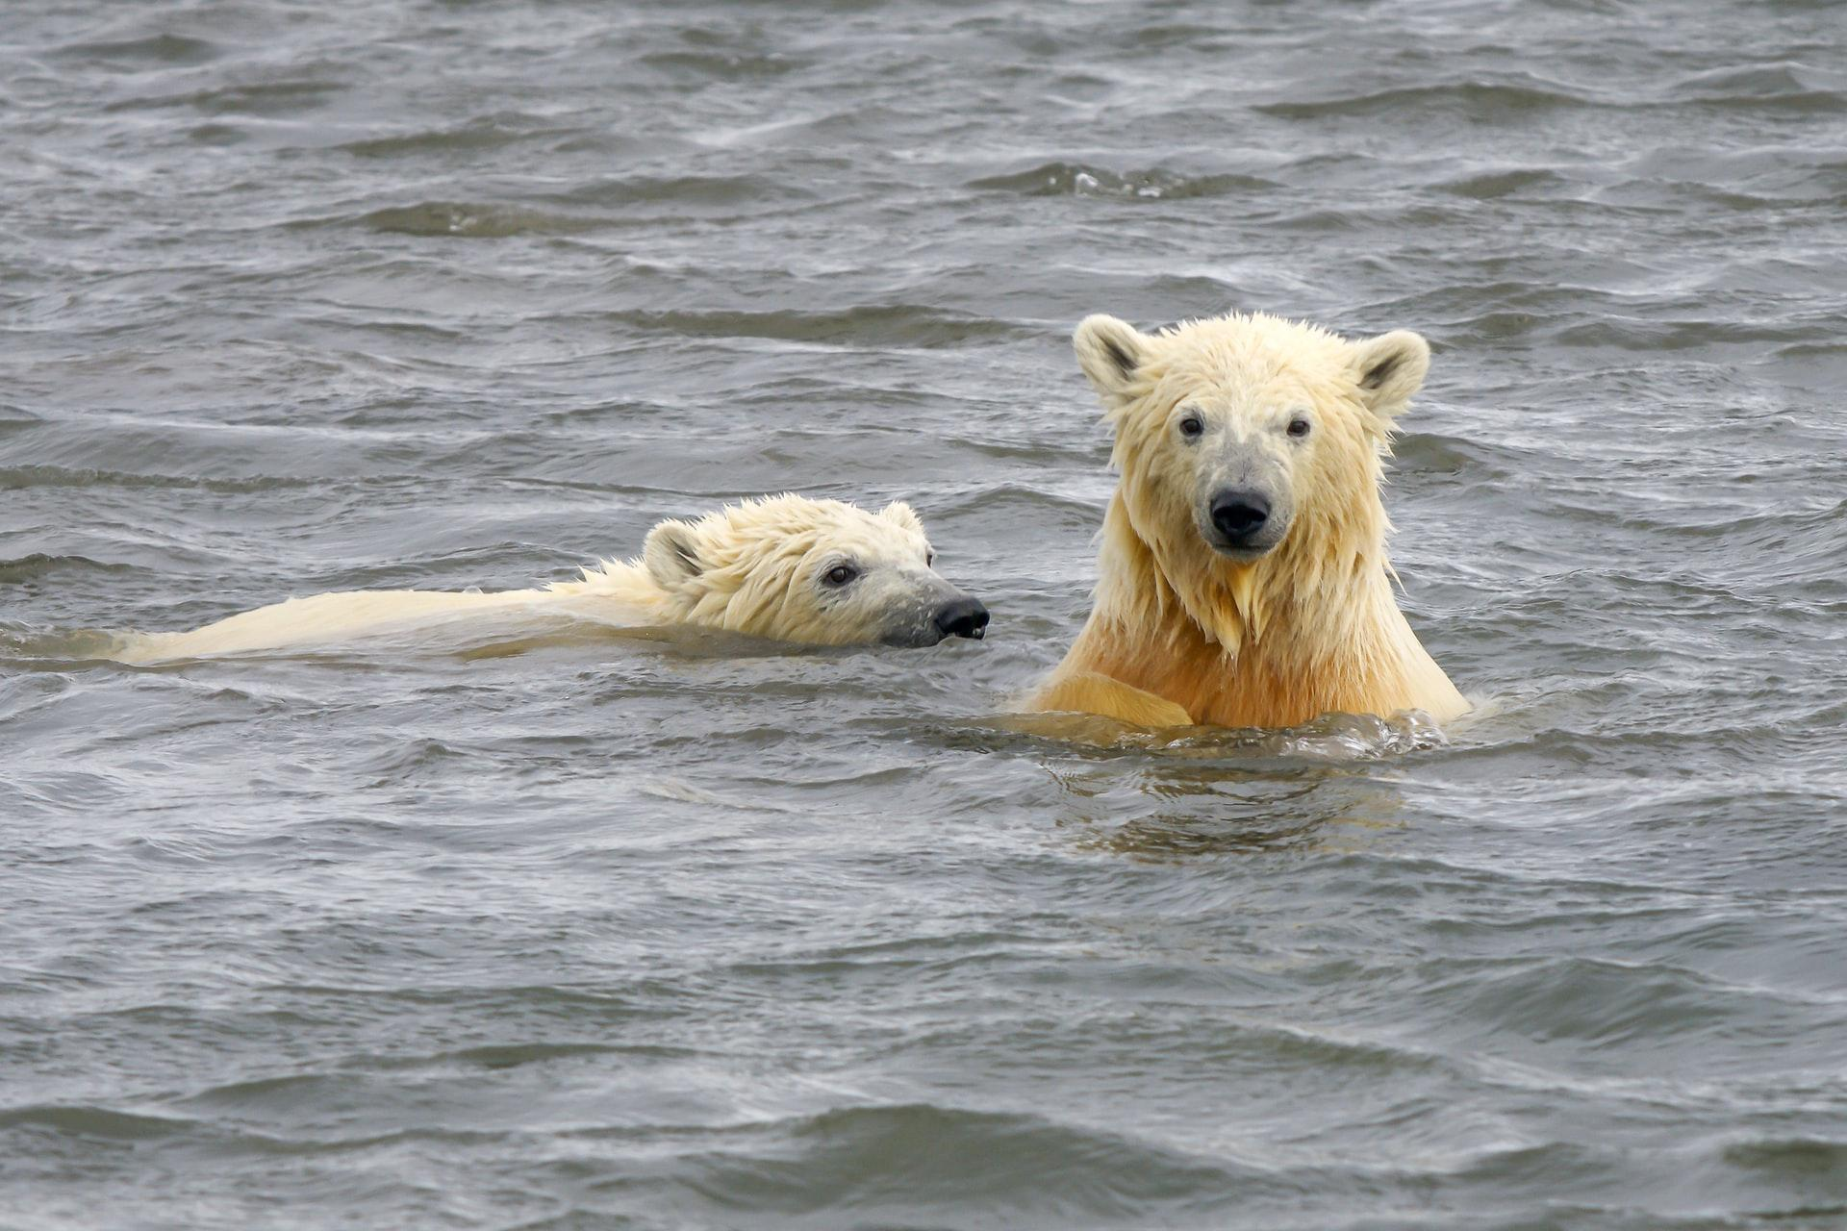

Display 1
Display 2
09/09 8:35 AM
DVD
Video
DVD
Video
Preview
Video
PC
Mac
DVD
DVD Preview
DVD Preview
Audio
Wired Mic
Table Mic
Go Live
Miscellaneous
Lights
Projectors
DVD Duplicate
DVD Controller
Settings
Enter Fullscreen

Slide 3
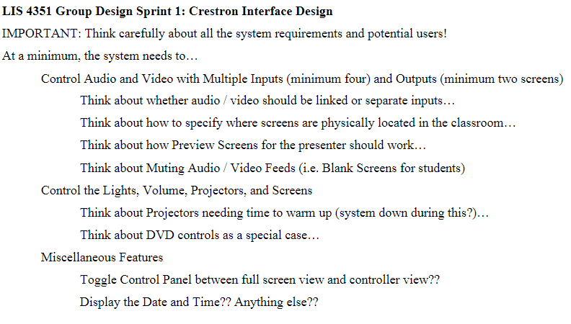

Slide 4
